Slide 1
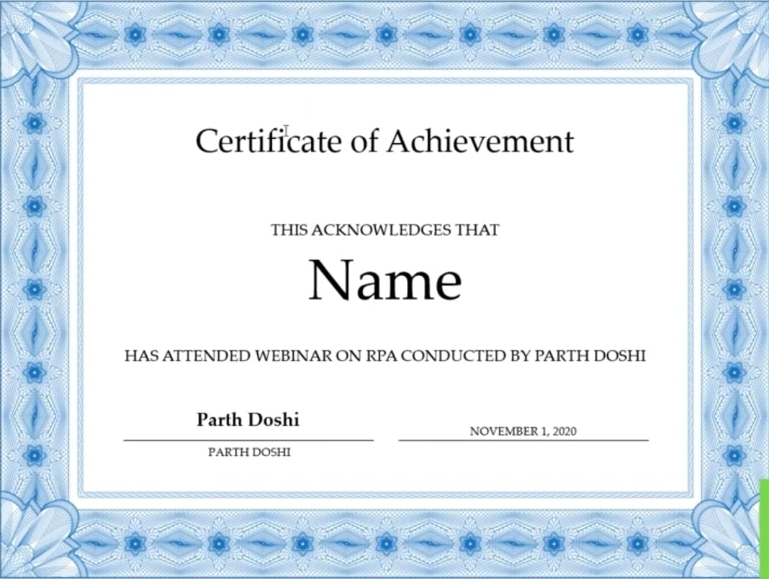
Certificate of Participation
THIS ACKNOWLEDGES THAT
Anjali Bhavani
HAS PARTICIPATED IN Hackthon CONDUCTED BY
Agmr varur | BRANCH: CSE
MRS. KAVITHA
SEPTEMBER 28,2026

